Slide 1
L7. Machine Learning
(Regression)
https://github.com/JWarmenhoven/ISLR-python

Slide 2
What is Machine Learning?
data + model = prediction
Data : observations, experience,…
Model: a form of prior knowledge, assumptions, belief
Functional model
Probabilistic model
Prediction : the new knowledge obtained by combining the data and model
Regression
Classification
Clustering

Slide 3
What is Machine Learning?
Linear Regression
Support Vector Machine
Ensemble Methods
Decision Tree
Neural Network
Deep Learning
Regression
Supervised
Learning
Support Vector Machine
Discriminant Analysis
Naïve Bayes
Nearest Neighbor
Neural Network
Classification
Machine Learning
K-means
Gaussian Mixture
Hidden Markov Model
Hierarchical Clustering
Unsupervised
Learning

Slide 4
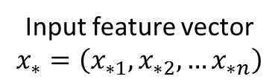
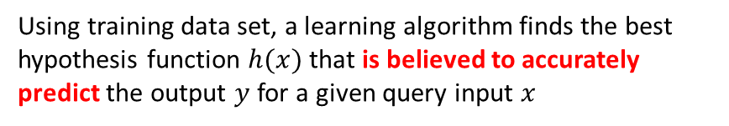
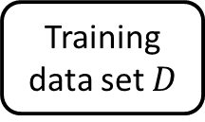



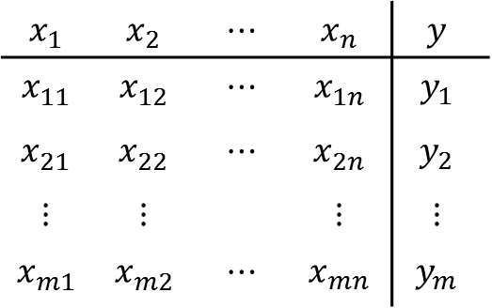

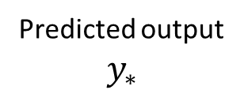

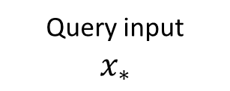
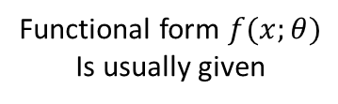

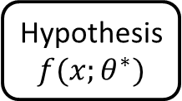


Supervised learning
Data
$$x_{1}$$ | $$x_{2}$$ | $$⋯$$ | $$x_{n}$$ | $$y$$
$$x_{11}^{ }$$ | $$x_{12}^{ }$$ | $$⋯$$ | $$x_{1n}^{ }$$ | $$y_{1}$$
$$x_{21}^{ }$$ | $$x_{22}^{ }$$ | $$⋯$$ | $$x_{2n}^{ }$$ | $$y_{2}$$
$$⋮$$ | $$⋮$$ |  | $$⋮$$ | $$⋮$$
$$x_{m1}^{ }$$ | $$x_{m2}^{ }$$ | $$⋯$$ | $$x_{mn}^{ }$$ | $$y_{m}$$
Training
data set $D$
$m$ input
Feature
vectors
$$D=\left\{\left(x_{i}^{ },y_{i}\right);i=1,…,m\right\}$$
$m$outputs
$$x_{i}^{ }=\left(x_{i1}^{ }, ⋯\text{,} x_{in}^{ } \right)$$
$$x_{i}^{ }=\left(x_{i1}^{ }, ⋯\text{,} x_{in}^{ } \right)$$
model
Learning
Algorithm
Using training data set, a learning algorithm finds the best hypothesis function $h(x)$ that is believed to accurately predict the output $y$ for a given query input $x$
Functional form $f(x;θ)$
Is usually given
prediction
$$\hat{θ}$$
Query input
$$x_{∗}$$
Hypothesis
$$f(x;θ^{∗})$$
Predicted output
$$y_{∗}$$
Input feature vector
$$x_{∗}=\left(x_{∗1},x_{∗2},…x_{∗n}\right)$$
if$y_{∗}∈ℝ$ : Regression
if$y_{∗}∈\{1,…,N\}$ : Classification

Slide 5
Two different learning approaches
Machine Learning as Optimization
Relate variables through a basis function (parametric function)
Formulate learning problem as an optimization problem
Employ optimization algorithm to solve the formulated problem
Machine Learning as Probabilistic Modeling (not necessarily Bayesian)
Relate variables through probability distributions
Formulate learning problem as inference
If Bayesian, treat parameters with probability distributions
Requires inference methods (integral or sampling) to solve the formulated problem
Let’s explore different views on Machine Learning by taking a linear regression as an example

Slide 6


Slide 7
Load Map
Optimization Approach (Normal Equation)
Maximum Likelihood Estimation (MLE) Approach
Maximum A Posteriori Estimation (MAP) Approach
Full Bayesian Approach
Analytical approach
Sampling approach
Regularization regression (Ridge and Lasso)
Optimization view
Bayesian View

Slide 8

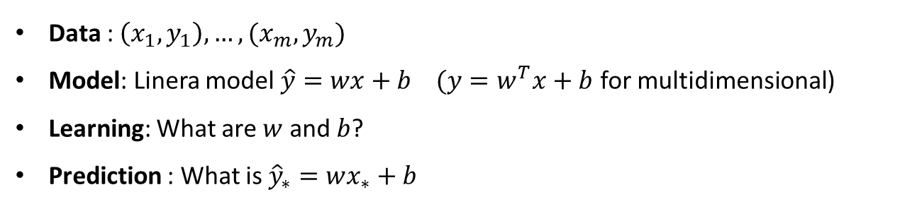



1D Linear Regression
$$y$$
$$\hat{y}=wx+b$$
Prediction
$$x$$
$$x_{∗}$$
Data : $\left(x_{1}, y_{1}\right), …, (x_{m}, y_{m})$
Model: Linera model $\hat{y}=wx+b$ $(y=w^{T}x+b$ for multidimensional)
Learning: What are $w$ and $b$?
Prediction : What is ${\hat{y}}_{∗}=wx_{∗}+b$

Slide 9
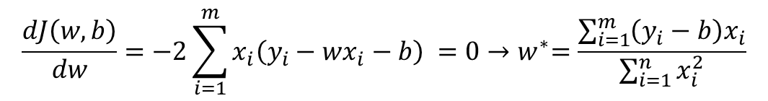

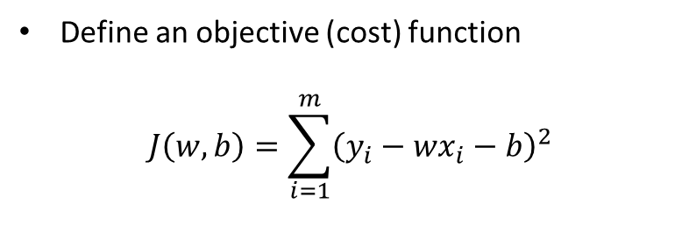




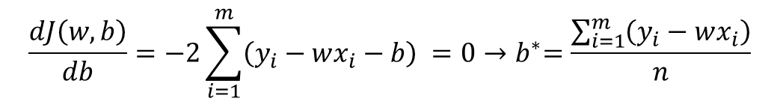

Learning as optimization
Define an objective (cost) function
$$J\left(w,b\right)=\sum_{i=1}^{m}{{\left(y_{i}−wx_{i}−b\right)}^{2}}$$
$$y$$
$$y=wx+b$$
$$y_{i}$$
$$\left(y_{i}−wx_{i}−b\right)$$
$$x_{i}$$
$$x$$
Minimize the error function with respect to $w$ and $b$
$$\frac{dJ\left(w,b\right)}{dw}=−2\sum_{i=1}^{m}{x_{i}{\left(y_{i}−wx_{i}−b\right)}^{ }}=0{→w}^{∗}=\frac{\sum_{i=1}^{m}{\left(y_{i}−b\right)x_{i}}}{\sum_{i=1}^{n}{x_{i}^{2}}}$$
$$\frac{dJ\left(w,b\right)}{db}=−2\sum_{i=1}^{m}{{\left(y_{i}−wx_{i}−b\right)}^{ }}=0{→b}^{∗}=\frac{\sum_{i=1}^{m}{\left(y_{i}−wx_{i}\right)}}{n}$$

Slide 10
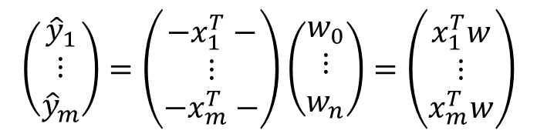

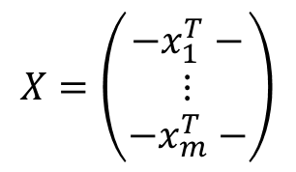




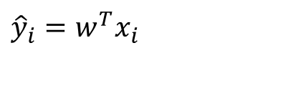

Learning as optimization
Notation for general cases $x_{i}∈ℝ^{n}$
A linear regression model
$${\hat{y}}_{i}=w_{0}+w_{1}x_{i1}+…+w_{n}x_{in}$$
with $w={\left(w_{0,}w_{1},…, w_{n}\right)}^{T}$ and $x_{i}={\left(x_{i1},…,x_{in}\right)}^{T}$
If we introduce $x_{i0}=1$,
$${\hat{y}}_{i}=w^{T}x_{i}$$
with $w={\left(w_{0},w_{1},…, w_{n}\right)}^{T}$ and $x_{i}={\left(x_{i0}, x_{i1},…,x_{in}\right)}^{T}$
1
In a Matrix form
$$\left(\begin{matrix}{\hat{y}}_{1} \\ ⋮ \\ {\hat{y}}_{m}\end{matrix}\right)=\left(\begin{matrix}{−x}_{1}^{T}− \\ ⋮ \\ {−x}_{m}^{T}−\end{matrix}\right)\left(\begin{matrix}w_{0} \\ ⋮ \\ w_{n}\end{matrix}\right)=\left(\begin{matrix}x_{1}^{T}w \\ ⋮ \\ x_{m}^{T}w\end{matrix}\right)$$
$$→\hat{y}=Xw$$
$m:$ # of data points
$$X=\left(\begin{matrix}{−x}_{1}^{T}− \\ ⋮ \\ {−x}_{m}^{T}−\end{matrix}\right)$$
with
$$\hat{y}={\left({\hat{y}}_{1}, …,{\hat{y}}_{m}\right)}^{T},$$

Slide 11
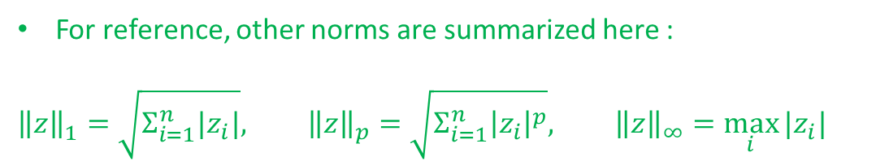
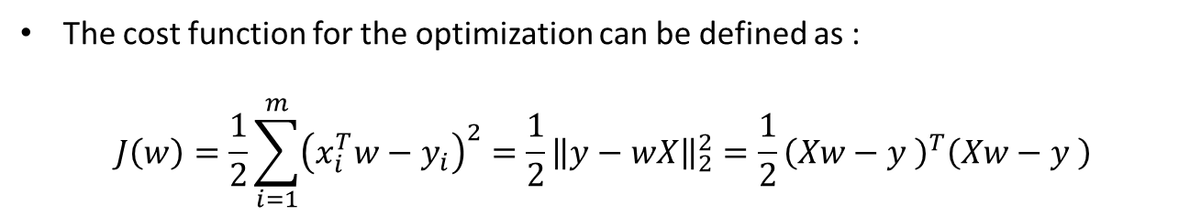
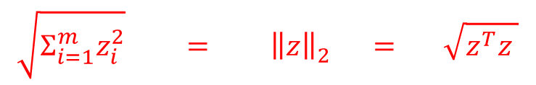
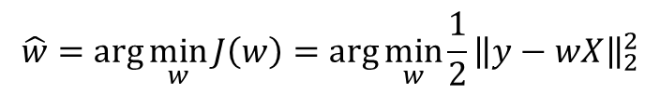
Learning as optimization (Normal Equation)
The cost function for the optimization can be defined as :
$$J\left(w\right)=\frac{1}{2}\sum_{i=1}^{m}{{\left(x_{i}^{T}w−y_{i}\right)}^{2}=\frac{1}{2}{\left\|y−wX\right\|}_{2}^{2}=\frac{1}{2}{\left(Xw−y \right)}^{T}\left(Xw−y \right)}$$
$$\sqrt{Σ_{i=1}^{m}z_{i}^{2}} = {\left\|z\right\|}_{2}^{ } = \sqrt{z^{T}z }$$
The optimum parameters $\hat{w}$ cam be computed as one minizing the cost function :
$$\hat{w}=arg\min_{w}{J\left(w\right)=arg\min_{w}{\frac{1}{2}{\left\|y−wX\right\|}_{2}^{2}}}$$
For reference, other norms are summarized here :
$${\left\|z\right\|}_{1}^{ }=\sqrt{Σ_{i=1}^{n}|z_{i}|}, {\left\|z\right\|}_{p}^{ }=\sqrt{Σ_{i=1}^{n}{\left|z_{i}\right|}^{p}}, {\left\|z\right\|}_{∞}^{ }=\max_{i}{|z_{i}|}$$

Slide 12
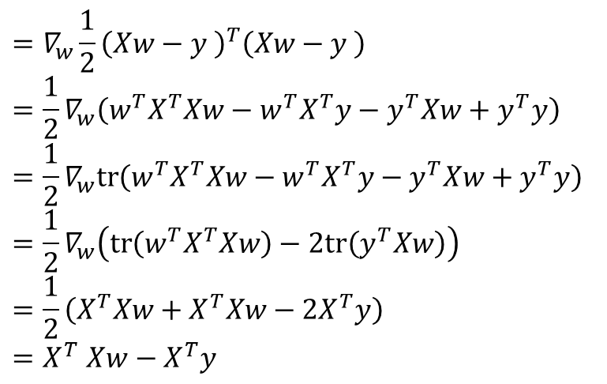


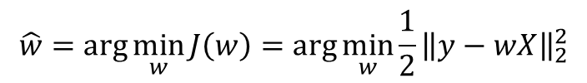

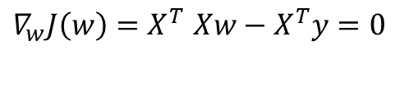
Learning as optimization (Normal Equation)
Linear Algebra Approach for finding the optimum parameters:
$$\hat{w}=arg\min_{w}{J\left(w\right)=arg\min_{w}{\frac{1}{2}{\left\|y−wX\right\|}_{2}^{2}}}$$
Optimality condition : $∇_{w}J\left(w\right)=0$ at $\hat{w}$
$$∇_{w}J\left(w\right)$$
$$=∇_{w}\frac{1}{2}{\left(Xw−y \right)}^{T}\left(Xw−y \right)$$
$$=\frac{1}{2}∇_{w}\left(w^{T}X^{T}Xw−w^{T}X^{T}y−y^{T}Xw+y^{T}y\right)$$
$$=\frac{1}{2}∇_{w}tr\left(w^{T}X^{T}Xw−w^{T}X^{T}y−y^{T}Xw+y^{T}y\right)$$
$$=\frac{1}{2}∇_{w}\left(tr\left(w^{T}X^{T}Xw\right)−2tr\left(y^{T}Xw\right)\right)$$
$$=\frac{1}{2}\left(X^{T}Xw+X^{T}Xw−2X^{T}y\right)$$
$${=X}^{T}Xw−X^{T}y$$
$$∇_{w}J\left(w\right){=X}^{T}Xw−X^{T}y=0$$
$$→X^{T}Xw=X^{T}y$$
$$→\hat{w}={\left(X^{T}X\right)}^{−1}X^{T}y$$

Slide 13




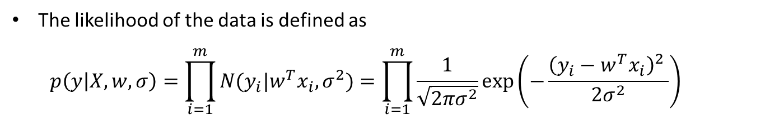
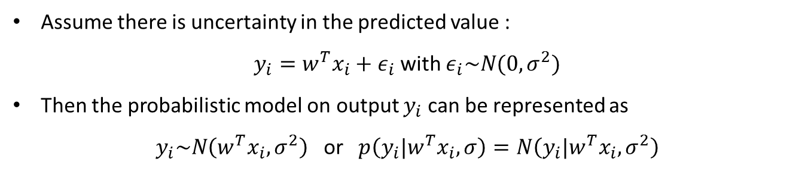





Probabilistic view on linear regression
Assume there is uncertainty in the predicted value :
$y_{i}=w^{T}x_{i}+ε_{i}$ with $ε_{i}\sim N(0, σ^{2})$
Then the probabilistic model on output $y_{i}$ can be represented as
$y_{i}\sim N\left(w^{T}x_{i}, σ^{2}\right)$ or $p\left(y_{i}|w^{T}x_{i}, σ\right)=N\left(y_{i}|w^{T}x_{i}, σ^{2}\right)$
$$σ$$
$$ε_{i}\sim N(0, σ^{2})$$
$$ε_{i}$$
$$x_{i}$$
$$w$$
$$y_{i}$$
$$y_{i}=w^{T}x_{i}+ε_{i}$$
$$y_{i}\sim N\left(w^{T}x_{i}, σ^{2}\right)$$
$$i=1,…,m$$
An error $ε_{i}$ is independently identically distributed (i.i.d assumption)
The likelihood of the data is defined as
$$p\left(y | X,w,σ\right)=\prod_{i=1}^{m}{N(y_{i}|w^{T}x_{i}, σ^{2})}=\prod_{i=1}^{m}{\frac{1}{\sqrt{2πσ^{2}}}\exp\left(−\frac{{\left(y_{i}−w^{T}x_{i}\right)}^{2} }{2σ^{2}}\right)}$$

Slide 14
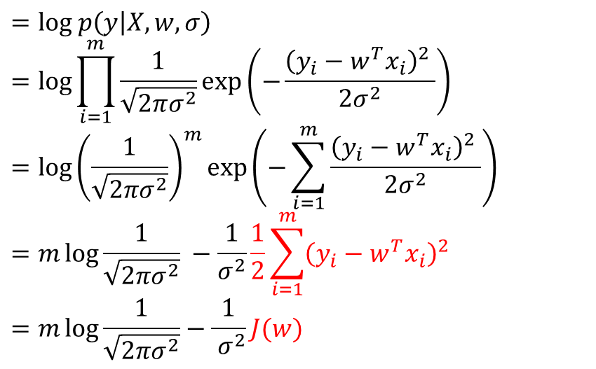

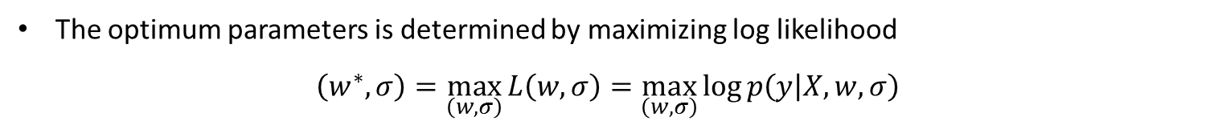

Learning as probabilistic model (MLE Approach)
The log likelihood is
$$L\left(w,σ\right)$$
$$=log p\left(y | X,w,σ\right)$$
$$=\log{\prod_{i=1}^{m}{\frac{1}{\sqrt{2πσ^{2}}}\exp\left(−\frac{{\left(y_{i}−w^{T}x_{i}\right)}^{2} }{2σ^{2}}\right)}}$$
$$=\log{{\left(\frac{1}{\sqrt{2πσ^{2}}}\right)}^{m}\exp\left(−\sum_{i=1}^{m}{\frac{{\left(y_{i}−w^{T}x_{i}\right)}^{2} }{2σ^{2}}}\right)}$$
$$=m\log{\frac{1}{\sqrt{2πσ^{2}}}} −\frac{1}{σ^{2}}\frac{1}{2}\sum_{i=1}^{m}{{\left(y_{i}−w^{T}x_{i}\right)}^{2}}$$
$$=m\log{\frac{1}{\sqrt{2πσ^{2}}}}−\frac{1}{ σ^{2}}J(w)$$
The optimum parameters is determined by maximizing log likelihood
$$\left(w^{∗},σ\right)=\max_{\left(w,σ\right)}{L\left(w,σ\right)}=\max_{\left(w,σ\right)}{\log{p\left(y | X,w,σ\right)}}$$
Minimizing the square error sum $J\left(w\right)=$
Maximizing the log likelihood $log p\left(y | X,w,σ\right)$ with respect to $w$

Slide 15


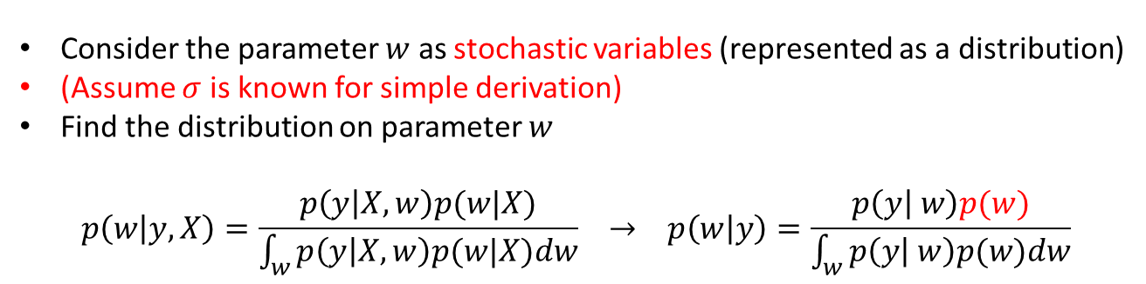















Learning as probabilistic model (Bayesian Approach)
MLE approach (point estimation)
Bayesian approach
Fixed hyper-parameter
Fixed hyper-parameter
$$σ$$
$$σ$$
$$α$$
Fixed parameter
$$ε_{i}$$
$$x_{i}$$
$$w$$
$$ε_{i}$$
$$x_{i}$$
$$w$$
$$ε_{i}\sim N(0, σ^{2})$$
$$p\left(w\right)=N(w|0,α^{2}I\text{)}$$
$$y_{i}$$
$$y_{i}$$
$$y_{i}=w^{T}x_{i}+ε_{i}$$
$$i=1,…,n$$
$$i=1,…,n$$
$$y_{i}\sim N\left(w^{T}x_{i}, σ^{2}\right)$$
Consider the parameter $w$ as stochastic variables (represented as a distribution)
(Assume $σ$ is known for simple derivation)
Find the distribution on parameter $w$
$$p\left(w | y,X\right)=\frac{p\left(y | X, w\right)p(w|X)}{\int_{w}^{ }{p\left(y | X,w\right)p(w|X)dw}} → p\left(w | y\right)=\frac{p\left(y | w\right)p(w)}{\int_{w}^{ }{p\left(y | w\right)p(w)dw}}$$
We will assume $X$ is fixed for the data $y$

Slide 16

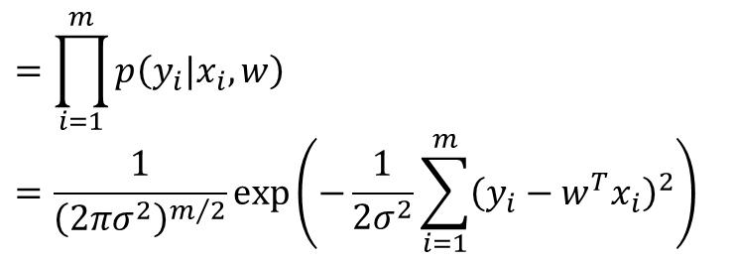



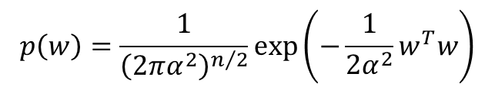

Learning as probabilistic model (Bayesian Approach)
Multivariate regression likelihood is
$$=\prod_{i=1}^{m}{p\left(y_{i}|x_{i},w\right)}$$
$$=\frac{1}{{\left(2πσ^{2}\right)}^{m/2}}\exp\left(−\frac{1}{2σ^{2}}\sum_{i=1}^{m}{{\left(y_{i}−w^{T}x_{i}\right)}^{2}}\right)$$
$$p\left(y | w\right)$$
$m=\#$ of data points
Multivariate Gaussian prior on parameter $w$
$p\left(w\right)=N(w|0,α^{2}I$)
$$p\left(w\right)=\frac{1}{{\left(2πα^{2}\right)}^{n/2}}\exp\left(−\frac{1}{2α^{2}}w^{T}w\right)$$
$n=$ Dimension of $w$

Slide 17
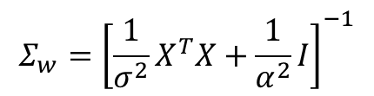
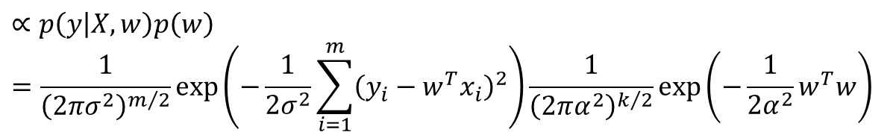
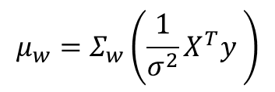


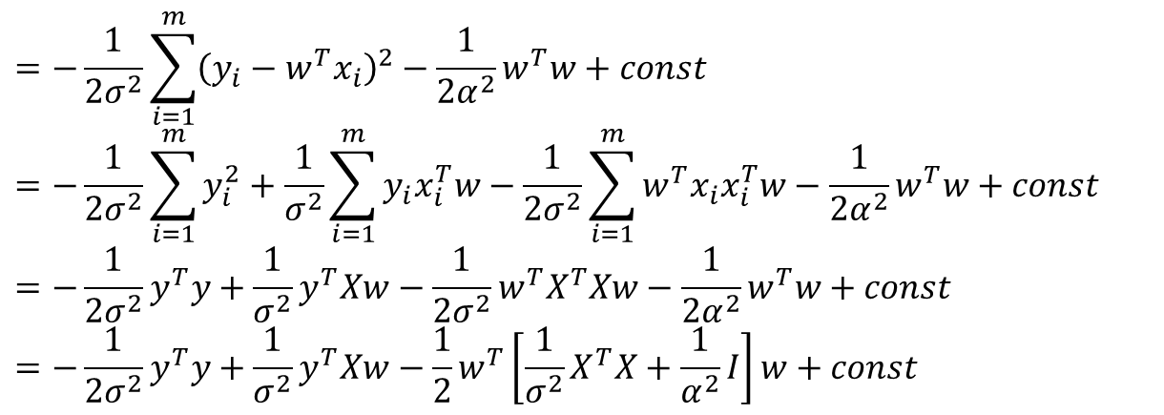

Learning as probabilistic model (Bayesian Approach)
We want to find the posterior
$$p\left(w | X,y \right)$$
$$∝p\left(y | X,w\right)p\left(w\right)$$
$$=\frac{1}{{\left(2πσ^{2}\right)}^{m/2}}\exp\left(−\frac{1}{2σ^{2}}\sum_{i=1}^{m}{{\left(y_{i}−w^{T}x_{i}\right)}^{2}}\right)\frac{1}{{\left(2πα^{2}\right)}^{k/2}}\exp\left(−\frac{1}{2α^{2}}w^{T}w\right)$$
Take log:
$$=−\frac{1}{2σ^{2}}\sum_{i=1}^{m}{{\left(y_{i}−w^{T}x_{i}\right)}^{2}}−\frac{1}{2α^{2}}w^{T}w+const=−\frac{1}{2σ^{2}}\sum_{i=1}^{m}{y_{i}^{2}}+\frac{1}{σ^{2}}\sum_{i=1}^{m}{y_{i}x_{i}^{T}w}−\frac{1}{2σ^{2}}\sum_{i=1}^{m}{w^{T}x_{i}x_{i}^{T}w}−\frac{1}{2α^{2}}w^{T}w+const$$
$$=−\frac{1}{2σ^{2}}y^{T}y+\frac{1}{σ^{2}}y^{T}Xw−\frac{1}{2σ^{2}}w^{T}X^{T}Xw−\frac{1}{2α^{2}}w^{T}w+const$$
$$=−\frac{1}{2σ^{2}}y^{T}y+\frac{1}{σ^{2}}y^{T}Xw−\frac{1}{2}w^{T}\left[\frac{1}{σ^{2}}X^{T}X+\frac{1}{α^{2}}I\right]w+const$$
$$logp\left(w | X,y \right)$$
Posterior distribution is
$$p\left(w | X,y\right)=N(w|μ_{w}, Σ_{w})$$
$$μ_{w}=Σ_{w}\left(\frac{1}{σ^{2}}X^{T}y \right)$$
$$Σ_{w}={\left[\frac{1}{σ^{2}}X^{T}X+\frac{1}{α^{2}}I\right]}^{−1}$$

Slide 18
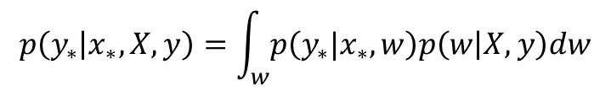
Learning as probabilistic model (Bayesian Approach)
Predicative distribution
$$p\left(y_{∗} | x_{∗},X, y\right)=\int_{w}^{ }{p\left(y_{∗}|x_{∗},w\right)p\left(w | X,y\right)dw}$$
Jupyter Demo Simulation
Bayesian Regression Analytical

Slide 19
Learning as probabilistic model (Bayesian Approach)
Predicative distribution
$$p\left(y_{∗} | x_{∗},X, y\right)=\int_{w}^{ }{p\left(y_{∗}|x_{∗},w\right)p\left(w | X,y\right)dw}$$
Jupyter Demo Simulation
Bayesian Regression (Sampling using PyMC)

Slide 20
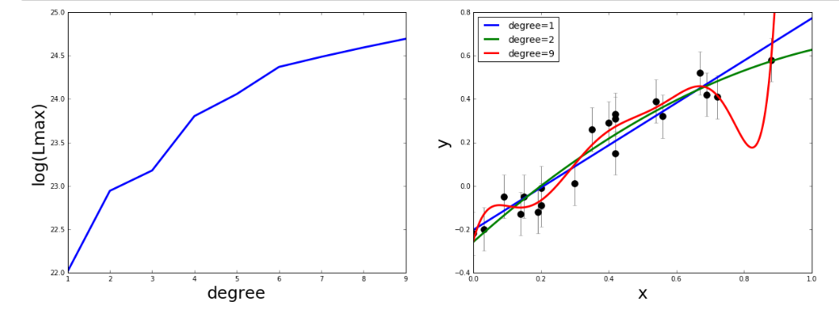
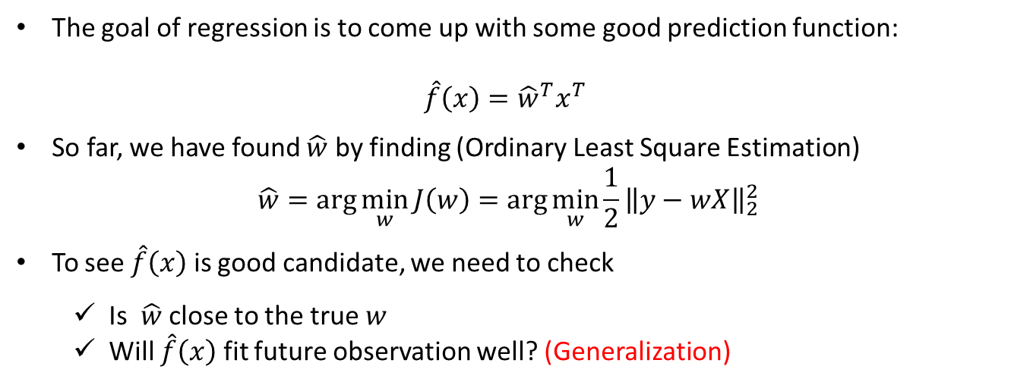
Regularized linear regression
What is a good regression function?
The goal of regression is to come up with some good prediction function:
$$\hat{f}\left(x\right)={{{\hat{w}}^{T}x}^{T}}^{ }$$
So far, we have found $\hat{w}$ by finding (Ordinary Least Square Estimation)
$$\hat{w}=arg\min_{w}{J\left(w\right)=arg\min_{w}{\frac{1}{2}{\left\|y−wX\right\|}_{2}^{2}}}$$
To see $\hat{f}\left(x\right)$ is good candidate, we need to check
Is $\hat{w}$ close to the true $w$
Will $\hat{f}\left(x\right)$ fit future observation well? (Generalization)

Slide 21
Regularized linear regression
Jupyter Demo Simulation
Regularization Motivation Example

Slide 22
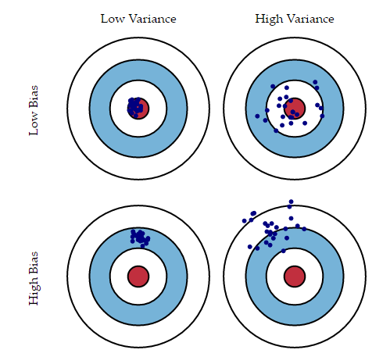
The Bias and Variance Trade off
Each hit represents an individual realization of our model, given the chance variability in the training data we gather.
Imagine you could repeat the whole model building process more than once: each time you gather new data and run a new analysis creating a new model.
Due to randomness in the underlying data sets, the resulting models will have a range of predictions.
- Bias measures how far off in general these models' predictions are from the correct value
- Variance measures he variability of a model prediction for a given data point
Figure source : http://scott.fortmann-roe.com/docs/BiasVariance.html

Slide 23

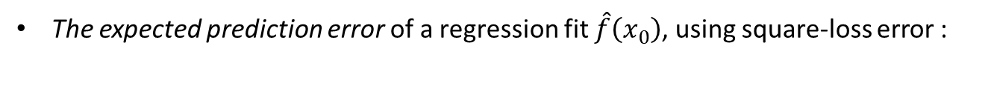

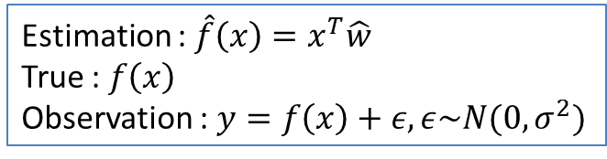


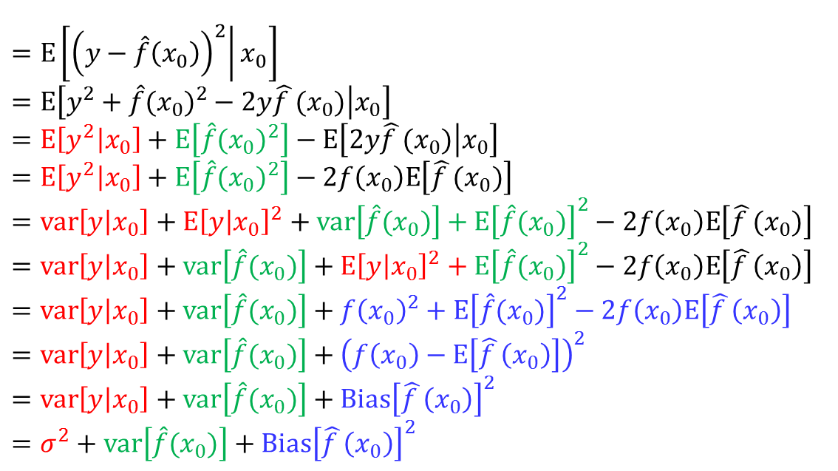
The Bias and Variance Trade off
Estimation : $\hat{f}\left(x\right)={x^{T}\hat{w}}^{ }$
True : $f\left(x\right)$
Observation : $y=f\left(x\right)+ε,ε\sim N(0,σ^{2})$
The expected prediction error of a regression fit $\hat{f}\left(x_{0}\right)$, using square-loss error :
$$EPP\left(x_{0}\right)$$
$$=E\left[\left.{\left(y−\hat{f}\left(x_{0}\right)\right)}^{2}\right|x_{0}\right]$$
$$=E\left[\left.y^{2}+{\hat{f}(x_{0})}^{2}−2y\hat{f }(x_{0})\right|x_{0}\right]$$
$$=E\left[\left.y^{2}\right|x_{0}\right]+E\left[{\hat{f}(x_{0})}^{2}\right]−E\left[\left.2y\hat{f }(x_{0})\right|x_{0}\right]$$
$$=E\left[\left.y^{2}\right|x_{0}\right]+E\left[{\hat{f}(x_{0})}^{2}\right]−2f\left(x_{0}\right)E\left[\hat{f }(x_{0})\right]$$
$$=var\left[y | x_{0}\right]+E{\left[y | x_{0}\right]}^{2}+var\left[\hat{f}(x_{0})\right]+E{\left[\hat{f}(x_{0})\right]}^{2}−2f\left(x_{0}\right)E\left[\hat{f }(x_{0})\right]$$
$$=var\left[y | x_{0}\right]+var\left[\hat{f}(x_{0})\right]+E{\left[y | x_{0}\right]}^{2}+E{\left[\hat{f}(x_{0})\right]}^{2}−2f\left(x_{0}\right)E\left[\hat{f }\left(x_{0}\right)\right]$$
$$=var\left[y | x_{0}\right]+var\left[\hat{f}(x_{0})\right]+f{\left(x_{0}\right)}^{2}+E{\left[\hat{f}(x_{0})\right]}^{2}−2f\left(x_{0}\right)E\left[\hat{f }\left(x_{0}\right)\right]$$
$$=var\left[y | x_{0}\right]+var\left[\hat{f}(x_{0})\right]+{\left(f\left(x_{0}\right)−E\left[\hat{f }\left(x_{0}\right)\right]\right)}^{2}$$
$$=var\left[y | x_{0}\right]+var\left[\hat{f}(x_{0})\right]+Bias{\left[\hat{f }\left(x_{0}\right)\right]}^{2}$$
$$=σ^{2}+var\left[\hat{f}(x_{0})\right]+Bias{\left[\hat{f }\left(x_{0}\right)\right]}^{2}$$
$$E\left[\left.2y\hat{f }(x_{0})\right|x_{0}\right]=E\left[\left.2\left(f\left(x\right)+ε\right)\hat{f }(x_{0})\right|x_{0}\right]$$
$=2E\left[\left.f\left(x\right)\hat{f }(x_{0})\right|x_{0}\right]+2E\left[\left.ε\hat{f }(x_{0})\right|x_{0}\right]$
$=2f\left(x_{0}\right)E\left[\hat{f }(x_{0})\right]+2E\left[\left.ε\hat{f }(x_{0})\right|x_{0}\right]$
$$=2f\left(x_{0}\right)E\left[\hat{f }(x_{0})\right]$$
$$(∵f\left(x_{0}\right) is constant)$$
$$(∵ε⊥\hat{f }\left(x_{0}\right))$$

Slide 24

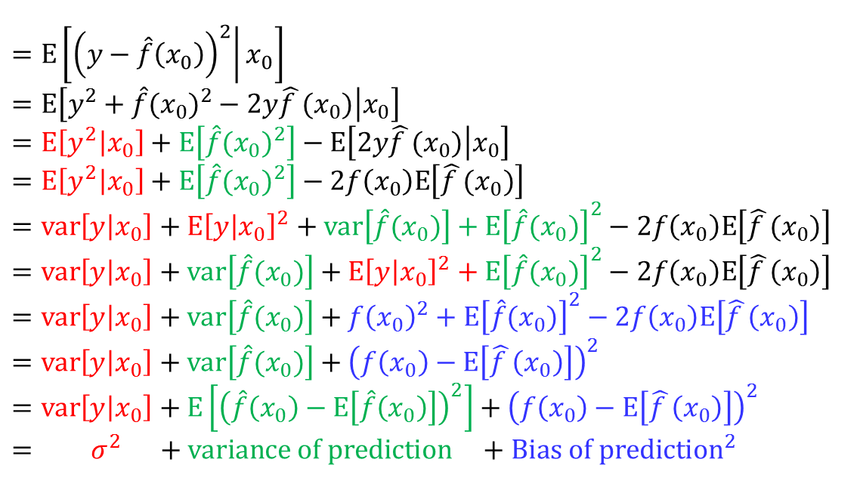
The Bias and Variance Trade off
Estimation : $\hat{f}\left(x\right)={x^{T}\hat{w}}^{ }$
True : $f\left(x\right)$
Observation : $y=f\left(x\right)+ε,ε\sim N(0,σ^{2})$
The expected prediction error of a regression fit $\hat{f}\left(x_{0}\right)$, using square-loss error :
$$=E\left[\left.{\left(y−\hat{f}\left(x_{0}\right)\right)}^{2}\right|x_{0}\right]$$
$$=E\left[\left.y^{2}+{\hat{f}(x_{0})}^{2}−2y\hat{f }(x_{0})\right|x_{0}\right]$$
$$=E\left[\left.y^{2}\right|x_{0}\right]+E\left[{\hat{f}(x_{0})}^{2}\right]−E\left[\left.2y\hat{f }(x_{0})\right|x_{0}\right]$$
$$=E\left[\left.y^{2}\right|x_{0}\right]+E\left[{\hat{f}(x_{0})}^{2}\right]−2f\left(x_{0}\right)E\left[\hat{f }(x_{0})\right]$$
$$=var\left[y | x_{0}\right]+E{\left[y | x_{0}\right]}^{2}+var\left[\hat{f}(x_{0})\right]+E{\left[\hat{f}(x_{0})\right]}^{2}−2f\left(x_{0}\right)E\left[\hat{f }(x_{0})\right]$$
$$=var\left[y | x_{0}\right]+var\left[\hat{f}(x_{0})\right]+E{\left[y | x_{0}\right]}^{2}+E{\left[\hat{f}(x_{0})\right]}^{2}−2f\left(x_{0}\right)E\left[\hat{f }\left(x_{0}\right)\right]$$
$$=var\left[y | x_{0}\right]+var\left[\hat{f}(x_{0})\right]+f{\left(x_{0}\right)}^{2}+E{\left[\hat{f}(x_{0})\right]}^{2}−2f\left(x_{0}\right)E\left[\hat{f }\left(x_{0}\right)\right]$$
$$=var\left[y | x_{0}\right]+var\left[\hat{f}(x_{0})\right]+{\left(f\left(x_{0}\right)−E\left[\hat{f }\left(x_{0}\right)\right]\right)}^{2}$$
$$=var\left[y | x_{0}\right]+E\left[{\left(\hat{f}\left(x_{0}\right)−E\left[\hat{f}\left(x_{0}\right)\right]\right)}^{2}\right]+{\left(f\left(x_{0}\right)−E\left[\hat{f }\left(x_{0}\right)\right]\right)}^{2}$$
$$= σ^{2} +variance of prediction +Bias of {prediction}^{2}$$
$$EPP\left(x_{0}\right)$$
$E$ is over the training data
Irreducible
Can balance

Slide 25



The Bias and Variance Trade off
Optimum model complexity
Square Error
The expected prediction error
$$EPP\left(x_{0}\right)$$
$$variance$$
$$Bias of {prediction}^{2}$$
Model complexity
Model complexity is related with
The number of model parameters
The size of model parameters
…

Slide 26
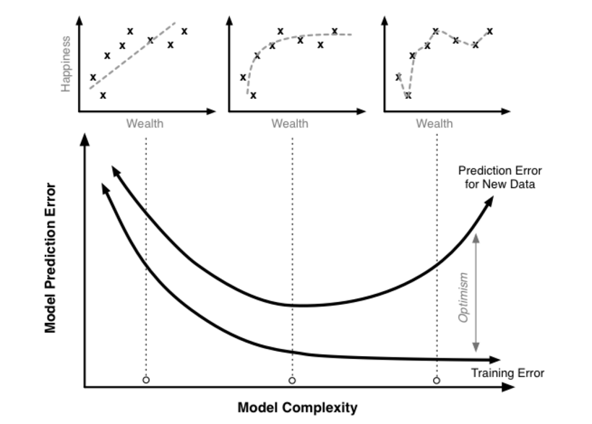
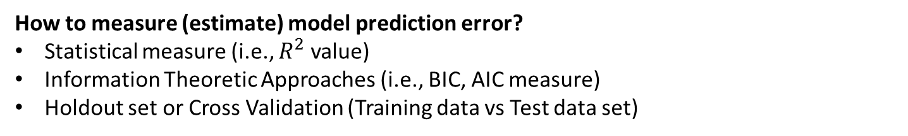
How to measure prediction error
How to measure (estimate) model prediction error?
Statistical measure (i.e., $R^{2}$ value)
Information Theoretic Approaches (i.e., BIC, AIC measure)
Holdout set or Cross Validation (Training data vs Test data set)

Slide 27
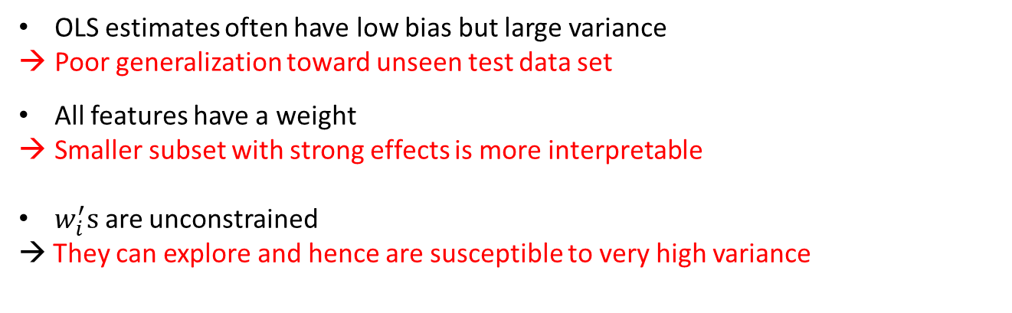
Regularized linear regression
Ordinary Least Square Estimation
OLS estimates find the parameter that minimize the bias between the predicted and true values :
$$\hat{w}=arg\min_{w}{{\left\|y−wX\right\|}_{2}^{2}}$$
OLS estimates often have low bias but large variance
Poor generalization toward unseen test data set
All features have a weight
Smaller subset with strong effects is more interpretable
$w_{i}^{′}s$ are unconstrained
→ They can explore and hence are susceptible to very high variance
We nee some shrinkage (or regulation) to constraint $\hat{w}$

Slide 28


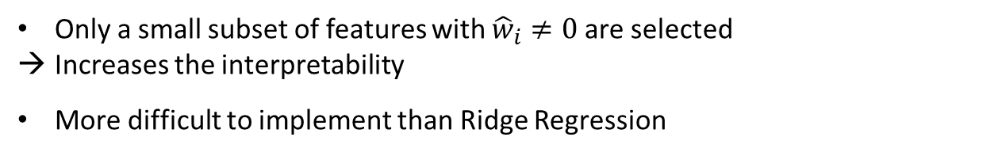
Regularized linear regression
Ridge regression
Ridge regression introduces a regularization with the L-2 norm:
$${\left\|w\right\|}_{2}^{ }=\sqrt{Σ_{i=1}^{k}w_{i}^{2}},$$
$$\hat{w}=arg\min_{w}{{\left\|y−wX\right\|}_{2}^{2}+{λ_{2}\left\|w\right\|}_{2}^{2}}$$
Sacrifice a little of bias to reduce the variance of predicted values
More stable and generalize better
Keep all the repressors in the model
Not easily interpretable model
Lasso (Least Absolute Shrinkage and Selection Operator)
Lasso regression introduces a regularization with the L-1 norm:
$$\hat{w}=arg\min_{w}{{\left\|y−wX\right\|}_{2}^{2}+{λ_{1}\left\|w\right\|}_{1}^{ }}$$
$${\left\|w\right\|}_{1}^{ }=Σ_{i=1}^{k}|w_{i}|$$
Only a small subset of features with ${\hat{w}}_{i}≠0$ are selected
Increases the interpretability
More difficult to implement than Ridge Regression

Slide 29
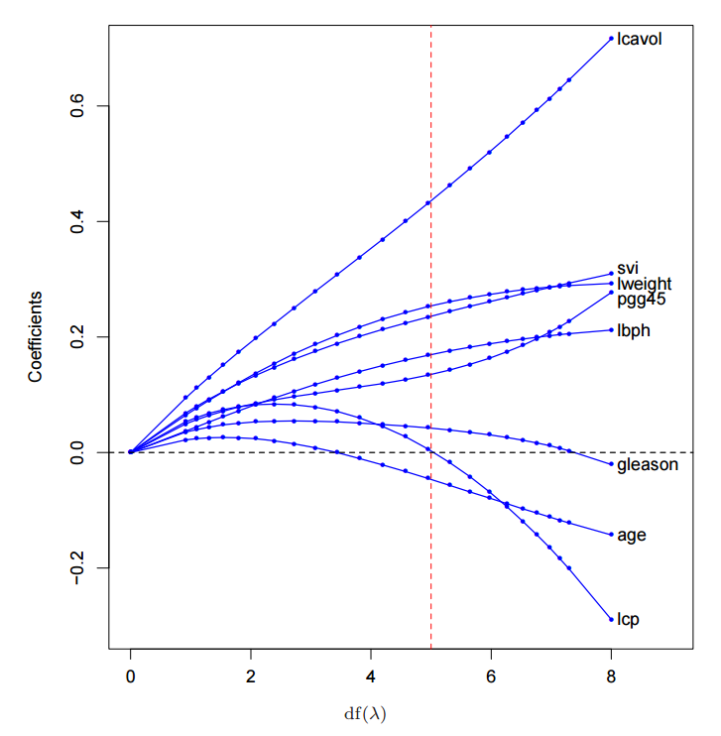
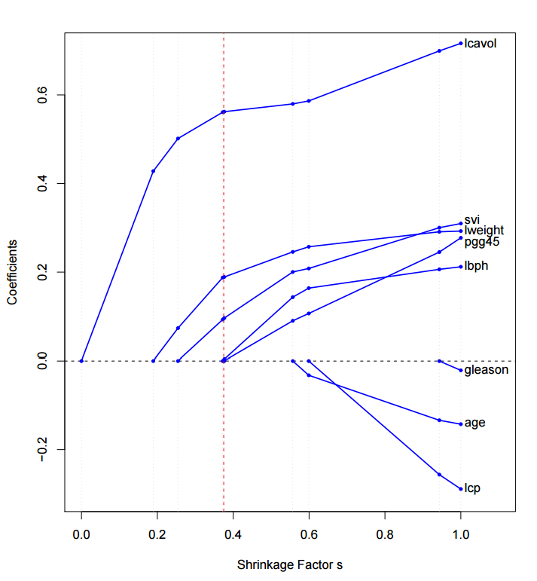




Regularized linear regression
Ridge regression
$$\hat{w}=arg\min_{w}{{\left\|y−wX\right\|}_{2}^{2}+{λ_{2}\left\|w\right\|}_{2}^{2}}$$
Large $λ_{2}$
Lasso (Least Absolute Shrinkage and Selection Operator)
$$\hat{w}=arg\min_{w}{{\left\|y−wX\right\|}_{2}^{2}+{λ_{1}\left\|w\right\|}_{1}^{ }}$$
Large $λ_{1}$

Slide 30
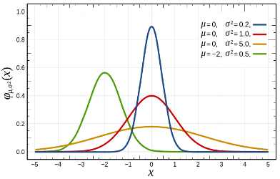







Bayesian view on Ridge regression
Ridge regression
MAP estimation view
$$\hat{w}=arg\min_{w}{{\left\|y−wX\right\|}_{2}^{2}+{λ_{2}\left\|w\right\|}_{2}^{2}}$$
$$\hat{w}=arg\max_{w}{logp\left(w | X,y\right)}=p\left(y | X,w\right)p\left(w\right)$$
Gaussian prior
$$p\left(w\right)=\frac{1}{{\left(2πα^{2}\right)}^{k/2}}\exp\left(−\frac{1}{2α^{2}}w^{T}w\right)$$
MAP estimation view
Lasso (Least Absolute Shrinkage and Selection Operator)
$$\hat{w}=arg\min_{w}{{\left\|y−wX\right\|}_{2}^{2}+{λ_{1}\left\|w\right\|}_{1}^{ }}$$
$$\hat{w}=arg\max_{w}{logp\left(w | X,y\right)}=p\left(y | X,w\right)p\left(w\right)$$
Laplace prior
$$p\left(w\right)=\prod_{i=1}^{k}{\frac{λ}{2\sqrt{τ^{2}}}\exp\left(−\frac{λ\left|w_{i}\right|}{ \sqrt{τ^{2}}}\right)}$$
MAP estimation view

Slide 31





Bayesian view on Ridge regression
$$p\left(y | X,w\right)={\prod_{i=1}^{m}{\frac{1}{{\left(2πσ^{2}\right)}^{1/2}}\exp\left(−\frac{{\left(y_{i}−w^{T}x_{i}\right)}^{2} }{2σ^{2}}\right)}}$$
$m$ : number of data points
$n$ : dimension of $w$
$$p\left(w\right)=N\left(w | 0, τ^{2}I\right)=\prod_{i=1}^{n}{\frac{1}{{\left(2πτ^{2}\right)}^{1/2}}\exp\left(−\frac{{\left(w_{i}−0\right)}^{2} }{2τ^{2}}\right)}=\frac{1}{{\left(2πτ^{2}\right)}^{n/2}}\exp\left(−\frac{1}{2τ^{2}}w^{T}w\right)$$
$$p\left(w | X,y \right)$$
$$∝p\left(y | X,w\right)p\left(w\right)$$
$$={\prod_{i=1}^{m}{\frac{1}{{\left(2πσ^{2}\right)}^{1/2}}\exp\left(−\frac{{\left(y_{i}−w^{T}x_{i}\right)}^{2} }{2σ^{2}}\right)\frac{1}{{\left(2πτ^{2}\right)}^{k/2}}\exp\left(−\frac{1}{2τ^{2}}w^{T}w\right)}}$$
$$={{\left(\frac{1}{{\left(2πσ^{2}\right)}^{1/2}}\right)}^{m}\frac{1}{{\left(2πτ^{2}\right)}^{n/2}}\exp\left(−\sum_{i=1}^{m}{\frac{{\left(y_{i}−w^{T}x_{i}\right)}^{2} }{2σ^{2}}}−\frac{1}{2τ^{2}}w^{T}w\right)}$$
$$log p\left(w | X,y \right)=m\log{\frac{1}{{\left(2πσ^{2}\right)}^{1/2}}}+log\frac{1}{{\left(2πτ^{2}\right)}^{n/2}}−\frac{1}{{2σ}^{2}}\left(\sum_{i=1}^{m}{{\left(y_{i}−w^{T}x_{i}\right)}^{2}}+\frac{σ^{2}}{τ^{2}}w^{T}w \right)$$
Maximum A Posteriori (MAP) estimation with Gaussian prior = Ridge Regression
$$\left(w^{∗}\right)=arg\max_{w}{logp\left(w | X,y\right)=arg\min_{w}{{\left\|y−wX\right\|}_{2}^{2}+{λ_{2}\left\|w\right\|}_{2}^{2}} }$$

Slide 32




Bayesian view on Lasso regression
$$p\left(y | X,w\right)={\prod_{i=1}^{m}{\frac{1}{{\left(2πσ^{2}\right)}^{1/2}}\exp\left(−\frac{{\left(y_{i}−w^{T}x_{i}\right)}^{2} }{2σ^{2}}\right)}}$$
$m$ : number of data points
$n$ : dimension of $w$
$$p\left(w\right)=Lap\left(w|λ, τ\right)=\prod_{i=1}^{n}{\frac{λ}{2\sqrt{τ^{2}}}\exp\left(−\frac{λ\left|w_{i}\right|}{ \sqrt{τ^{2}}}\right)}$$
$$p\left(w | X,y \right)$$
$$∝p\left(y | X,w\right)p\left(w\right)$$
$$={\prod_{i=1}^{m}{\frac{1}{{\left(2πσ^{2}\right)}^{1/2}}\exp\left(−\frac{{\left(y_{i}−w^{T}x_{i}\right)}^{2} }{2σ^{2}}\right){\left(\frac{λ}{2\sqrt{τ^{2}}}\right)}^{n}\exp\left(−\frac{λ}{ \sqrt{τ^{2}}}Σ_{i=1}^{n}\left|w_{i}\right|\right)}}$$
$$={{\left(\frac{1}{{\left(2πσ^{2}\right)}^{1/2}}\right)}^{m}{\left(\frac{λ}{2\sqrt{τ^{2}}}\right)}^{n}\exp\left(−\sum_{i=1}^{m}{\frac{{\left(y_{i}−w^{T}x_{i}\right)}^{2} }{2σ^{2}}}−\frac{λ}{ \sqrt{τ^{2}}}Σ_{i=1}^{n}\left|w_{i}\right|\right)}$$
$$log p\left(w | X,y \right)=m\log{\frac{1}{{\left(2πσ^{2}\right)}^{1/2}}}+nlog\frac{λ}{2\sqrt{τ^{2}}}−\frac{1}{{2σ}^{2}}\left(\sum_{i=1}^{m}{{\left(y_{i}−w^{T}x_{i}\right)}^{2}}+\frac{{2σ}^{2}λ}{\sqrt{τ^{2}}}Σ_{i=1}^{n}\left|w_{i}\right|\right)$$
Maximum A Posteriori estimation with Laplacian prior = Lasso regression
$$\left(w^{∗}\right)=arg\max_{w}{logp\left(w | X,y\right)=arg\min_{w}{{\left\|y−wX\right\|}_{2}^{2}+{λ_{1}\left\|w\right\|}_{1}^{ }} }$$

Slide 33
Bayesian view on Lasso regression
Jupyter Demo Simulation
Ridge and Lasso Simulation

Slide 34
Bayesian Model Selection

Slide 35



Bayesian Approach for Model Selection
Model fitting proceeds by assuming a particular model is true, and tuning the model so it provides the best possible fit to the data
Model selection, on the other hand, asks the larger question of whether the assumptions of the model are compatible with the data.
Linear model:
$$y_{M1}=f_{M1}\left(x;w\right)=w_{0}+w_{1}x$$
$$y\sim N(y_{M1},σ_{y}^{2})$$
Quadratic model:
$$y_{M2}=f_{M2}\left(x;w\right)=w_{0}+w_{1}x+w_{2}x^{2}$$
$$y\sim N(y_{M2},σ_{y}^{2})$$
Which model is better ?

Slide 36

Model Complexity and Generality
Comparing maximum likelihood $p\left(D | w,M_{1}\right)$ and $p\left(D | w,M_{2}\right)$ is not a good idea
$$\lim_{w}{p\left(D | w,M_{1}\right)} v.s. \lim_{w}{p\left(D | w,M_{2}\right)}$$
As more complex model is used, model better fits the data, however, this model cannot predict well on unseen test data
Balancing between model fitting and generalization is a fundamental question in ML
In frequentist approach, a complex model is penalized by additional regularization term
The Bayesian approach addresses this by integrating over the model parameter space, which in effect acts to automatically penalize overly-complex models.

Slide 37






Bayesian Approach for Model Selection
The parameter posterior given the model $M$ is expressed
$$p\left(w | D,M\right)=\frac{p\left(D | w,M\right)p\left(w|M\right)}{p(D|M)}$$
The model posterior can be expressed
$$p\left(M | D\right)=\frac{p\left(D | M\right)p(M)}{p(D)}$$
$$\text{where} p\left(D | M\right)=\int_{w}^{ }{p\left(D,w | M\right)}=\int_{Ω }^{ }{p\left(D | w,M\right)p\left(w | M\right)dθ}$$
(Integration over the entire parameter space $w∈Ω$)
The odd ratio between two models, $M_{1} and M_{2},$ can be expressed
$$O_{21}=\frac{p\left(M_{2} | D\right)}{p\left(M_{1} | D\right)}={\frac{p\left(D | M_{2}\right)}{p\left(D | M_{1}\right)}}_{ }\frac{p\left(M_{2}\right)}{p\left(M_{1}\right)}$$
$0_{21}>$ thredhold
Choose $M_{2}$
${\frac{p\left(D | M_{2}\right)}{p\left(D | M_{1}\right)}}_{ }:$Bayes factors
$$\frac{p\left(M_{2}\right)}{p\left(M_{1}\right)}$$
: Prior odd ratio

